Slide 1
Railway Reservarion System
MOPIDEVI VAISHNAVI

Slide 2
ABSTRACT
The Indian Railways (IR) carries about 5.5 lakhs passengers in reserved accommodation every day. The Computerised Passenger Reservation System(PRS) facilates the booking and cancellation of tickets from any of the4000 terminals (i.e. PRS booking window all over the countries).TheseticketscanbebookedorcancelledforjourneyscommencinginanypartofIndiaandendinginanyotherpart,withtraveltimeaslongas72hoursanddistance up to several thousand kilometers . In the given project we will be developing a website which will help users to find train details,bookandcancelticketsandtheexactratesoftheirticketstothedesired destination . With the help of online booking people can book their tickets online through internet , sitting in their home by a single click of mouse. Using their credit cards people can easily get their tickets done within minutes.

Slide 3
INTRODUCTION
General Overview
Our website has various kinds of information that helps regarding booking of tickets via railways Users will be able to search the train availability ,the exact fare ,the arrival and departure time of the train and they can also book the ticket by using the debit ,credit or master card and after booking the ticket if the user want to cancel it then they can easily do it also
Survey
Railway passengers frequently need to know about their ticket reservation status, ticket availability on a particular train or for a place, train arrival or departure details, special trains etc.. Customer information centers at the railway stations are unable to serve such queries at peak periods . The number of the reservation counters available to the passengers and customers are very less . On most of the reservation systems there are long queues , so it takes along time for any individual to book the ticket . As now there are no call centers facilities available to solve the queries of the passengers .The online railway ticket reservation system aims to develop a web application which aims at providing trains details , trains availability , as well as the facility to book ticket in online for customers . So, we thought of developing a web based application which would provide the users all these facilities from his terminal only as well as help them in booking their tickets. The Application was to be divided into two parts namely the user part , and the administrator part. And each of these has their corresponding features . We decided to give the name of the website “ ONLINE RAILWAY TICKET RESEVATION ”. The online railway ticket reservation system is developed using ASP . NET with C# asthe backend in the .NET Framework.

Slide 4
OBJECTIVES
The objective of the online railway ticket reservation system Project is to design software to fully automate the process of issuing a railway ticket.
That is:-
To create a database of the trains To search the trains
it’s arrival and departure time , distance between source and destination .
To check the availability of the ticket .
To calculate fare.
To book the ticket.6.Tocanceltheticketifnecessary.

Slide 5
ANALYSIS
Online railway ticket reservation is a online ticket booking website, which is capable of booking ticket and search the train availability . This website is mainly created to fulfil the following requirements, it comprises of the following properties:
A central database that will store all information.
An online website that will provide real- time information about the availability of tickets their prices .
Every registered user is able to view his booking id that has been made in his/her name.
Every registered user can change his password anytime he wants to change.
Every guest user can search train availability , price of the ticket , arrivaland departure time ,distance between source and destination etc.
Every registered user has the facilities to print his ticket anytime he wishes . Administration login In admin mode the administrator can make changes in train details.He can also view all booking that has been made by different users.
The booking window contains all the facilities at one place , the user can simply login to his account and can book his ticket.

Slide 6
SOFTWARE REQUIREMENTS SPECIFICATIONS
Visual Studio Code

Slide 7
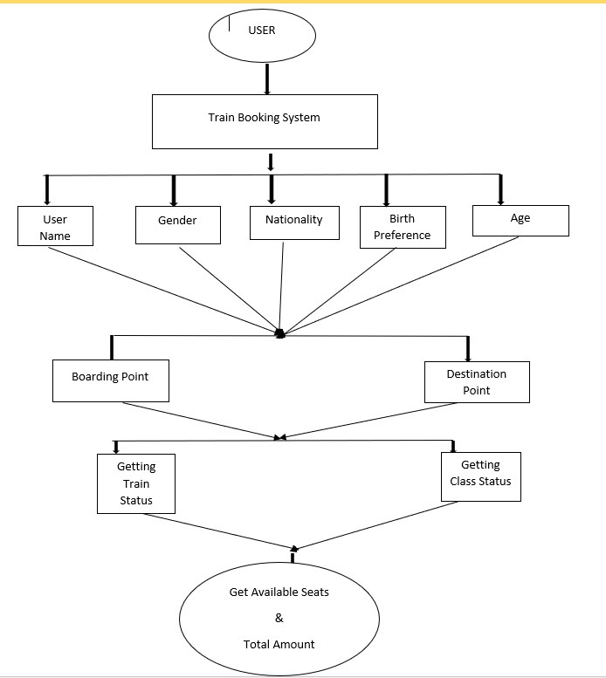
DESIGN

Slide 8
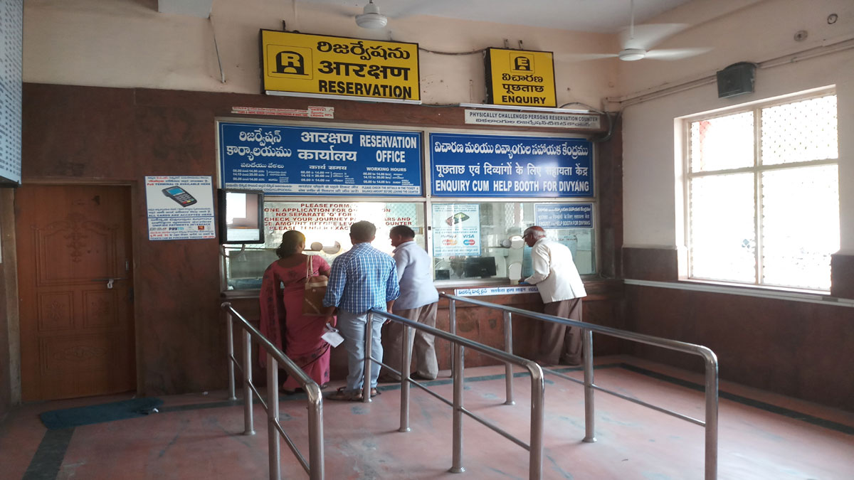
IMPLIMENTATION
Online railway ticket reservation system is a web based application . It has been developed using ASP . NET and C as the code end programming language. A Server database consisting of multiple tables is used for data storage . This Website is a online travel booking website , which is capable of booking tour of national and international destination with easy steps at the cheapest rate . It allows the Administrator to perform all operations and view bookings . The general user is however given only restricted access . Travel helps in booking tour packages . The user can’t book any tour until he is a registered user.

Slide 9
CONCLUSION
The main of developing reservation system is to provide all information that is required by the users. User friendliness is a must that is the user must get the details without complicated searching procedures .Other important requirements of software are data security, extensibility and maintainability.

